Slide 1
Twenty-Minute Mentor series engaging students Through asynchronous learning
Julie Miller
Associate Professor, Communication Arts & Sciences

Slide 2
Today’s twenty-minute mentor
Students don't have to be together in a physical or virtual classroom to be engaged. This session will provide you with some quick tips on ways to engage students on their own time through asynchronous learning.

Slide 3
My experiences with online teaching
Teaching hybrid and asynchronous classes since 2012
Several classes in the PR curriculum are taught as hybrid or completely online
Hybrid class is a 200-level class and it is designed to prepare students for online learning later in the curriculum, as well as their internships and careers

Slide 4
Getting started
Get organized!
Think about how you want to organize your content
Work with Instructional Design to develop a Bb class site that is easy to navigate, visually appealing and incorporates plagiarism software
Teaching an asynchronous class requires a substantial time commitment.
Don’t plan to “set it and forget it”.
If you aren’t engaged, it will be hard for students to be engaged.

Slide 5
Marco…polo!!
Again, get organized! Can’t stress this enough!
Set expectations for students and stick with them!
Design a syllabus that makes it easy for students to know what to do and where to go on the class site
If it’s hard to do, or locate, you’ve lost them.
Start each semester with entire class ready to run. This allows students a chance to get familiar with the class layout and focus on learning.
Be intentional and overcommunicate!

Slide 6
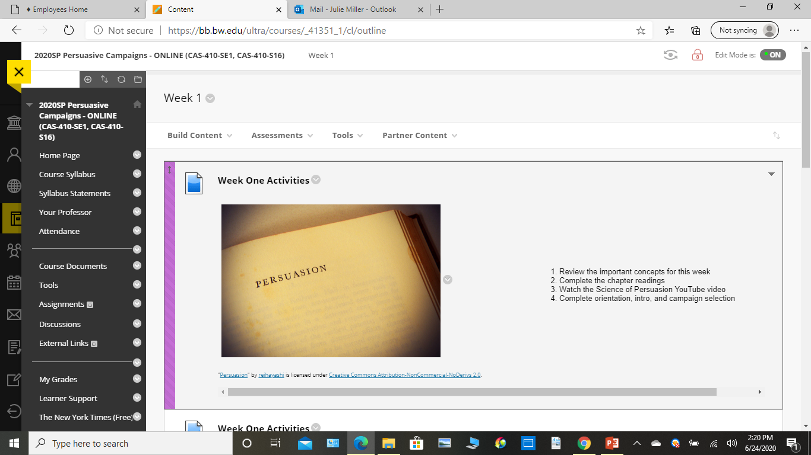
The syllabus
The syllabus should be the foundation for your class site.
Use it to build each week’s activities

Slide 7
Sample Week Layout

Slide 8
What’s the plan?
When developing each week’s learning objectives and activities, start with the outcome in mind.
What do you want students to be able to do at the end of the week or module?

Slide 9
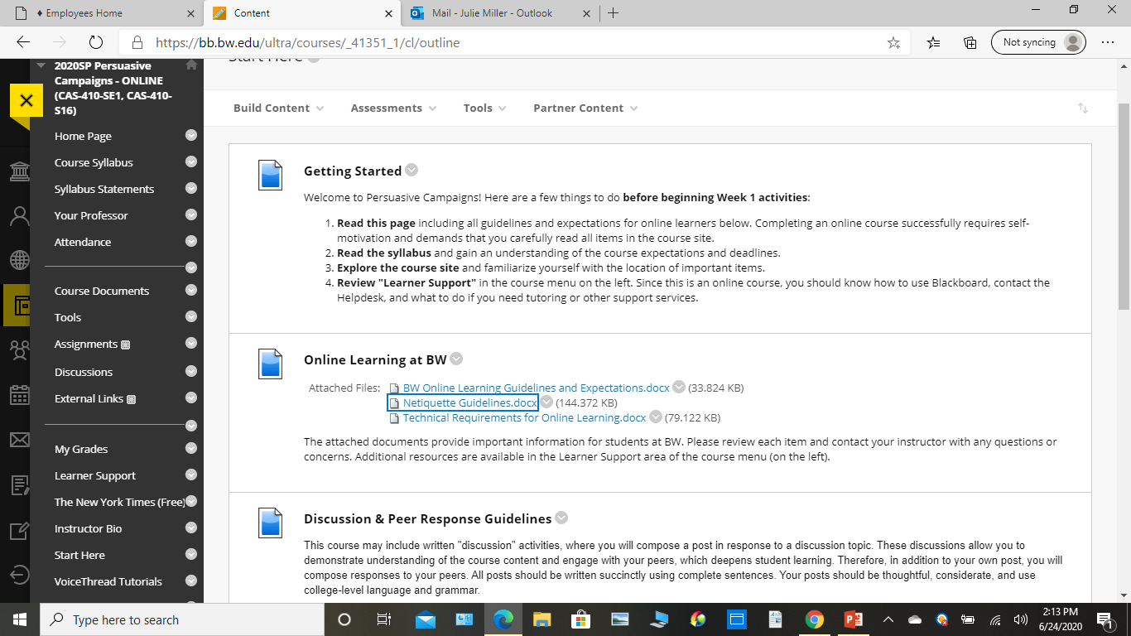
Where do I begin?
“Start Here” page

Slide 10
Sense of community
Video intros (faculty and students)
Welcome to class emails
Video introduction of syllabus
Set attendance expectations in syllabus
Online quiz to verify understanding of syllabus
Weekly reminders of work and deadlines
Mid-semester emails
Repeated reminders to meet to discuss class, etc. Calendly
Always use their names!

Slide 11
Respond! Respond! Respond!
No matter what you ask students to do, get ready to respond to their emails and work in a timely manner.
Set expectations for response times in the syllabus (one day, two days…)
Some assignments might require you checking and responding to posts multiple times a day.
Be realistic! If you don’t take the time to comment on their work, it’s harder to establish a sense of community.
Read posts thoroughly
Include expectations for respectful conversations in the syllabus.

Slide 12
Gold stars for all!
You set the tone for the class.
Be positive!
Give praise!
Send emails thanking students for excellent work
Make people want to be part of this class and your team
Again, this can take a considerable amount of time! Be ready!
Remember to make it easy for students to be engaged

Slide 13
Getting started Ideas!
Think back to your learning objectives. They should help you develop your weekly activities. (Backward course design)
Weekly PowerPoint lectures with voice overs
Tell stories with your lectures to illustrate key points
Weekly content builds on prior learning to complete weekly discussions, quizzes and projects
Discussion posts with peer responses (credit and extra credit)
Weekly videos (no more than 10-15 minutes)
Student surveys throughout class to determine engagement

Slide 14
Blackboard tools
Journals
Wikis
Meet rooms

Slide 15
Ready! Set! Go!
Agree/disagree posts based on lecture or current event (be professional)
“And another thing” posts based on case studies
Scavenger hunts based on current events
Cialdini’s Principles of Persuasion video posts
“Persuade Me” activity
“Real Life” - use this at my job or internship activity (a shelf to put it on)
“Two Truths and a Lie”
Early submission points
*All of the above can be done for credit or extra credit.

Slide 16
Pros and cons
Not all students will look forward to online learning
Time management challenges
Contacting students who disappear
Completing online grading in a meaningful and timely manner
Sticking with established deadlines and expectations
Giving and getting feedback remains important
Time and energy

Slide 17
feedback
Questions?
Thoughts?

Slide 18
Thank you!
Julie Miller
Associate Professor
Communication Arts and Sciences
Kleist 220
jamiller@bw.edu
440-826-2453

